Slide 1

Capital One Airline Data Challenge
Sreephani Devireddy June 2024

Slide 2

CONTEXT
The Airline company is considering entry into the US domestic market and seeks recommendations to inform its business decisions.
ANALYZE DATA AND PROVIDE INSIGHTS FOR THE BELOW:
The 10 busiest round-trip routes in terms of number of round-trip flights in the quarter. Exclude canceled flights when performing the calculation.
The 10 most profitable round-trip routes (without considering the upfront airplane cost) in the quarter. Along with the profit, show total revenue, total cost, summary values of other key components and total round-trip flights in the quarter for the top 10 most profitable routes. Exclude canceled flights from these calculations.
The 5 round trip routes that you recommend to invest in based on any factors that you choose.
The number of round-trip flights it will take to breakeven on the upfront airplane cost for each of the 5 round trip routes that you recommend. Print key summary components for these routes.
Key Performance Indicators (KPI’s) that you recommend tracking in the future to measure the success of the round-trip routes that you recommend.

Slide 3
Dataset Management Strategy
Datasets
Data Quality Assurance
Data Filtering and Restrictions
Limitations
Flights, Tickets, Airport Codes: Key datasets analyzed for insights into operational and market dynamics.
Validation: Ensured all columns contain intended values, addressing discrepancies promptly.
Formatting: Corrected data types to align with analytical requirements.
Outliers: Retained outliers for comprehensive analysis of operational performance and anomalies.
Missing Values: Applied robust imputation strategies, using medians for numeric columns to maintain dataset integrity.
Data Integrity: Removed invalid strings, ensuring datasets consist only of valid airport codes.
Duplicates: Eliminated duplicate entries across all columns to prevent data redundancy and ensure accuracy.
Focused Analysis: Filtered out cancelled flights, non-round trips, and non-US airports to tailor analysis to the US domestic market.
Data Linkage: Acknowledged challenges in linking tickets to their corresponding flights due to inherent data limitations, potentially impacting comprehensive analysis and insights.

Slide 4

Approach to Data Munging/Merging
Objective
Optimize analysis of busiest and most profitable flight routes through efficient data aggregation and merging.
Methodology
Aggregation
Aggregate FLIGHTS and TICKETS datasets by ORIGIN and DESTINATION.
Summarize key metrics: PASSENGERS, ITIN_FARE, and operational data.
Merging Strategy
Perform inner join on aggregated datasets to integrate flight and ticketing details.
Incorporate AIRPORT_CODES for airport classifications (large/medium).
Integration
Create unified dataset for comprehensive route analysis.
Evaluate profitability and operational efficiency of flight routes.
Benefits
Efficiency: Reduces computational complexity by aggregating before merging.
Insightful Analysis: Facilitates detailed exploration of busy and profitable routes.
Actionable Insights: Supports strategic decisions based on robust data analysis.

Slide 5
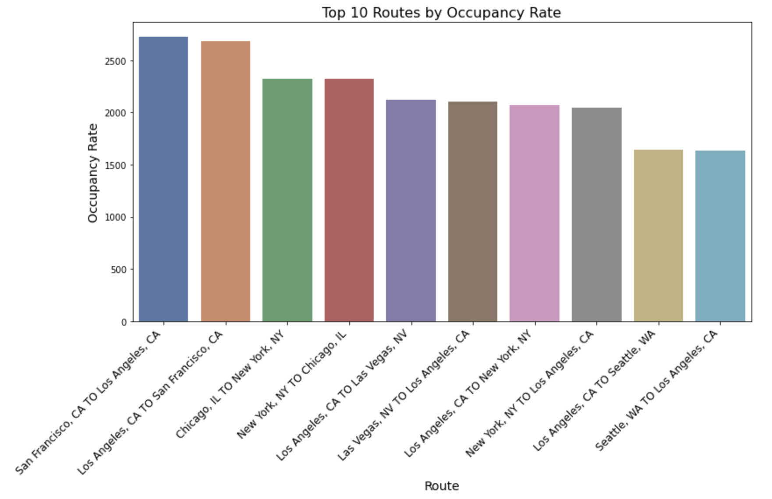
Top 10 Busy routes

Slide 6
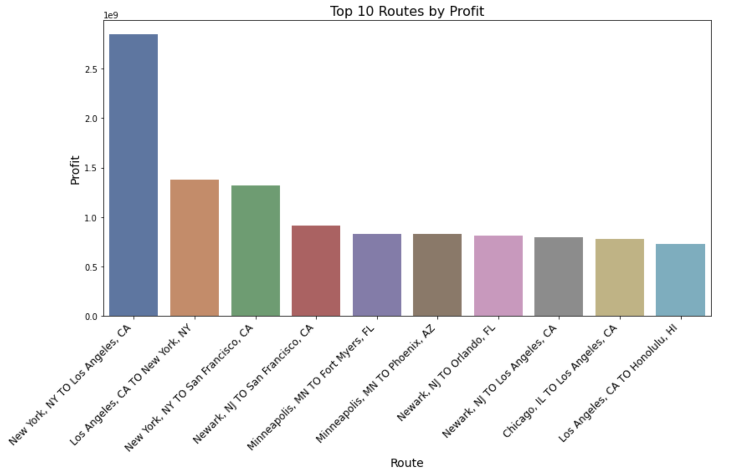
Top 10 Profitable routes

Slide 7
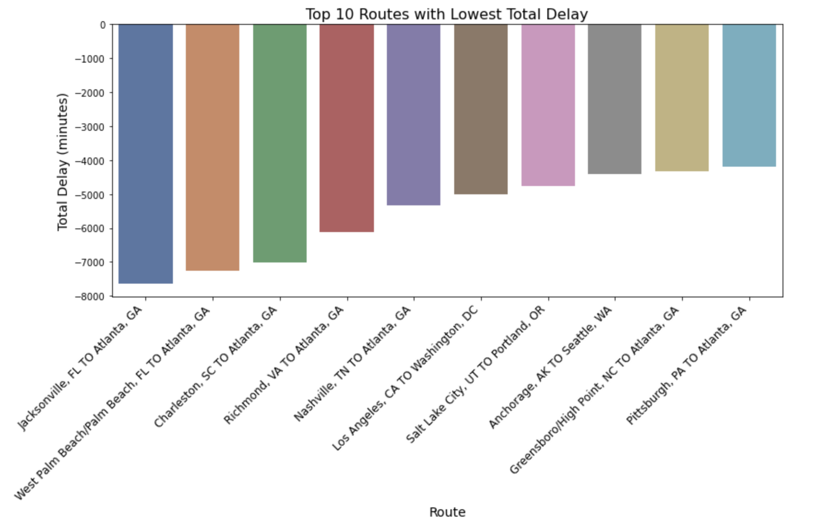
Top 10 Least Delay routes

Slide 8
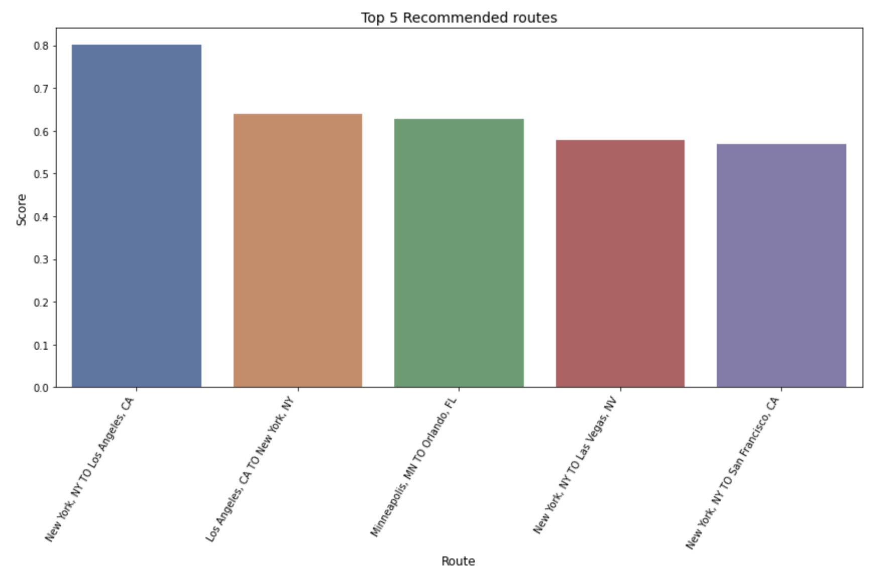
Top 5 Recommended Routes

Slide 9
Key Insights to Predictive Analysis
KPIs to consider:
Target Audience
Weather Impacts
Promotions and Pricing

